Slide 1

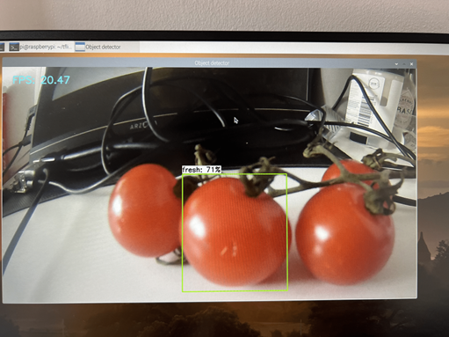
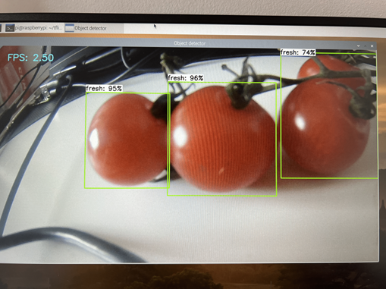
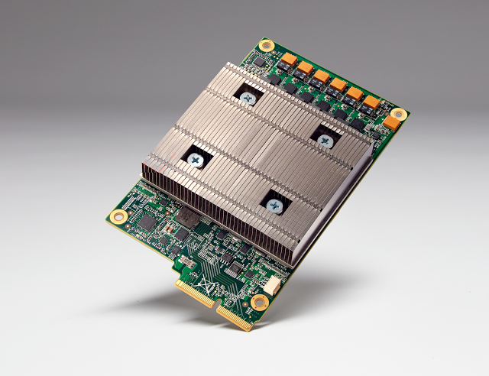
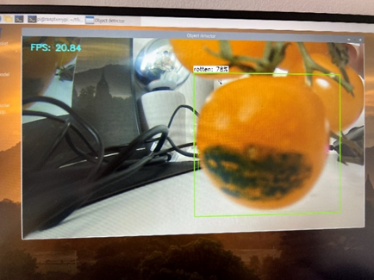
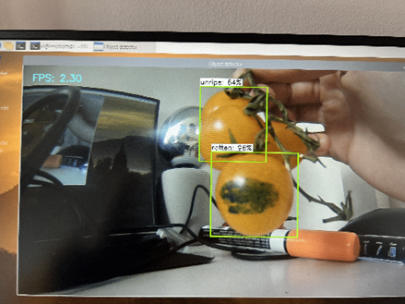
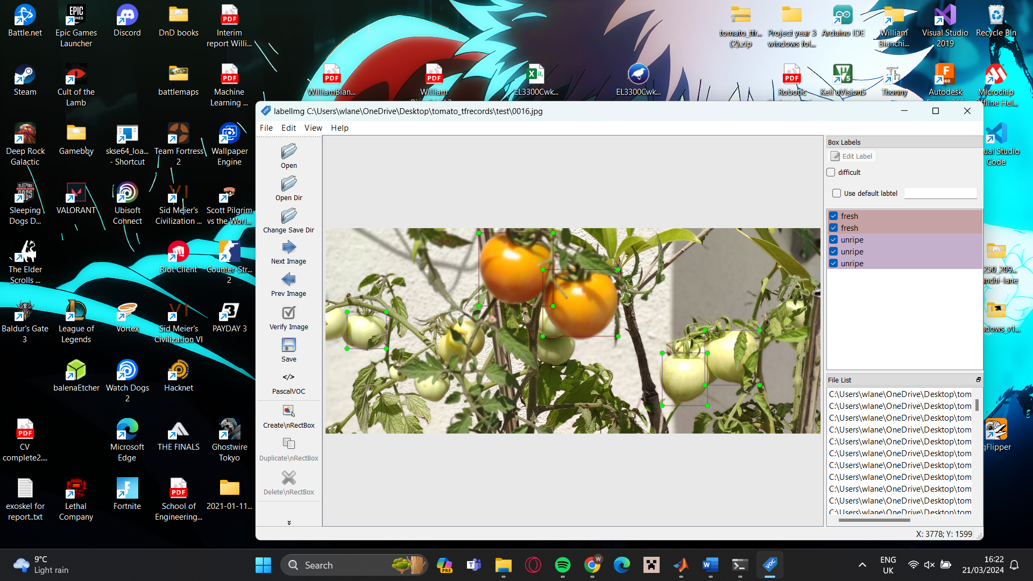
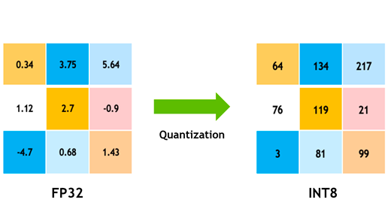
Machine Learning in Urban Agriculture
William Bianchi
BEng Robotics
Introduction
Results
This project displays the production of a custom Tensorflow Object detection model, designed to assist in quality control of agricultural produce. Aswell as showing the process of deploying it to a single board computer application.
Below are images of the model being ran on the tensor Processing unit and the model being run on the onboard CPU of the Raspberry Pi 4B.
TPU, Test on Fresh tomato
CPU, Test on Fresh tomato
Aims and Objectives
The project aims were as followed
Produce an accurate TensorFlow object detector to detect the state of a Tomato(unripe, fresh and rotten)
Quantize the Model to deploy on a single board computer
Compile the model to run on a Tensor Processing Unit for faster inferring and run the model at higher frames per second
TPU, test on unripe and simulated rotten
CPU, test on unrip and simulated rotten.
TPU chip designed by Google.
Marker pen was used to simulate rotting/ skin discoloration
The TPU would run the model at 19 to 20 frames, whereas the CPU would Run at 2 to 2.5 frames per second
Methodology
Model production starts with data collection and labelling the data with meta data used to find features during training
Future consideration and conclusion
The model when testes using the F1 scoring method for accuracy generated a score of 0.785 which is a high accuracy score, however in practical test the system did not perform well using the tensor processing unit. Only being able to detect 1 class at a time with confidence <85 whereas the model on the CPU running slower but far more accurate classification. For this project to be viable the practical application of the model must be optimized for the tensor processing unit.
Model training and quantization was completed in a google Colab notebook that connects to a cloud-based GPU speeding up the heavy computational load.
Quantisation of a model is size reduction technique that converts the model's weights from 32bit floating point numbers to 8-bit integers number not only speeding up the model also reducing its memory requirement.
References
Koul, A., Siddha Ganju and Meher Kasam (2019). Practical Deep Learning for Cloud, Mobile, and Edge. O’Reilly Media.
Google Cloud. (n.d.). Introduction to Cloud TPU. [online] Available at: https://cloud.google.com/tpu/docs/intro-to-tpu.
Acknowledgement
I would like to thank Stephen Sigurnjak for supervising this project and for pointing assisting with understanding my mistakes and how to remedy them. I would also like to thank UCLan for the opportunity to complete this degree and supporting me by giving me the resources for success.

